Slide 1

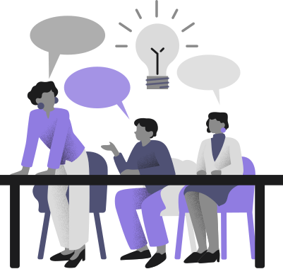
Studio: Unintentional Good
A2:
DEFINE &
IDEATE

Slide 2

What's Inside
01 | Intro
02 | Interviews & Insights
03 | POVs, HMWs, & Solutions
04 | Moving Forward

Slide 3
03
Intro

Slide 4
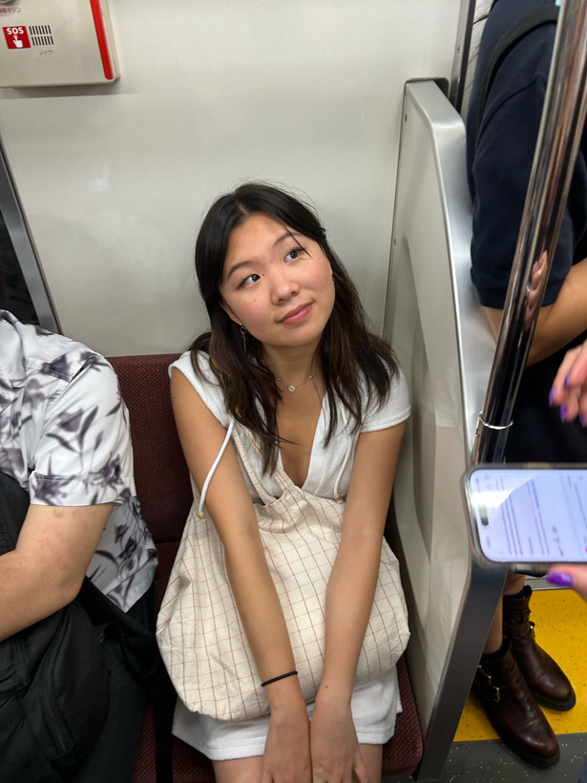
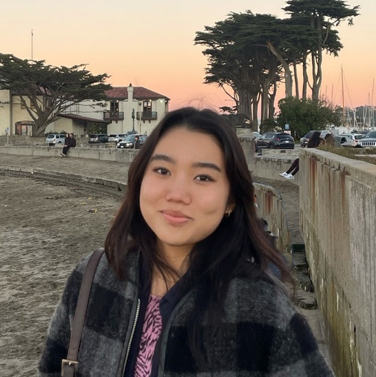
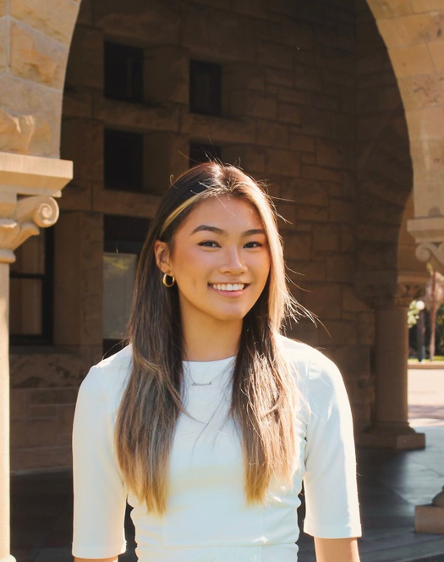
The Team
Emily Deng
Jenna Kim
Ariane Lee
Ariane Lee
Computer Science ‘25
Computer Science ‘25
Symbolic Systems ‘25
Computer Science ‘25

Slide 5
ORIGINAL DOMAIN
MOTHERS

Slide 6
ORIGINAL DOMAIN
MOTHERS
The apps that best supported mothers are the same ones that support us (ie. DoorDash, Uber, Venmo).
Mothers are not the only caregivers.

Slide 7
ORIGINAL DOMAIN
MOTHERS
The apps that best supported mothers are the same ones that support us (ie. DoorDash, Uber, Venmo).
Mothers are not the only caregivers.
Mothers are the extreme user. They experience life transitions all the time alongside their growing child.

Slide 8

ORIGINAL DOMAIN
MOTHERS
The apps that best supported mothers are the same ones that support us (ie. DoorDash, Uber, Venmo).
Mothers are not the only caregivers.
Mothers are the extreme user. They experience life transitions all the time alongside their growing child.
NEW DOMAIN
LIFE TRANSITIONS
Example: birth of a child, moving to a new city, death of a parent, going to a new school, etc.

Slide 9
02
Interviews & Insights

Slide 10
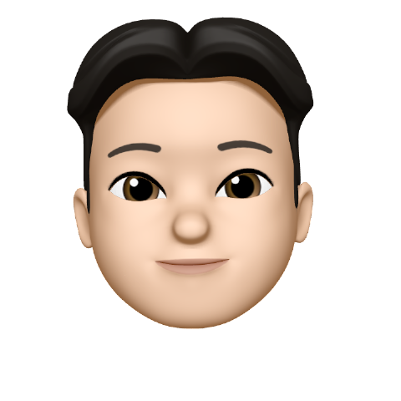
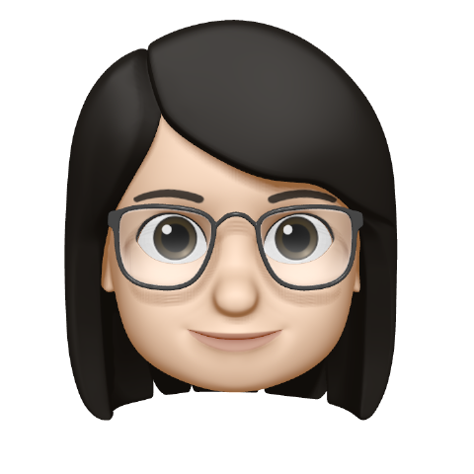
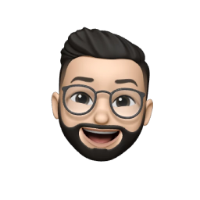



Alex,
22 yo New Grad & Growth Engineer
Xin,
Trust Engineer & Mother of 2 (7 yo, 3.5 yo)
Who we interviewed this week
Steven,
New University Lecturer, recently moved
Irena,
PWR Professor & Mother of 3 yo and currently pregnant
Angela & Ben,
25 yo & 33 yo Associates

Slide 11
Description
Calls his parents a lot to ask about things like healthcare, car maintenance + registration, etc.
As a growth engineer, he works on how to make the onboarding process for the user as easy as possible
Talked a lot about low activation energy
Tries a lot of new tools that are recommended by people he trusts (ie. prominent Tech Twitter accounts, friends)
Alex
“If the task I need to do is something that seems far away, like booking an annual check up, I’m probably not going to do it”
22 yo
San Francisco, CA
Growth Engineer

Slide 12

Description
Alex
22 yo
San Francisco, CA
Growth Engineer

Slide 13
Description
Recently started a new job and moved across the country to a new city after his mom died of cancer
Found it difficult to info about things like wills, family history, & his mom’s finances after she died, despite extensive preparation
Had a lot of responsibiliies at his old job and worked 80 hour workweeks
Only liked using productivity tools he could easily customize such as spreadsheets
Steven
Florida -> Bay Area
University Lecturer
“Since my mom died, I’m really cognizant of all the knowledge and information my dad has to offer.”

Slide 14
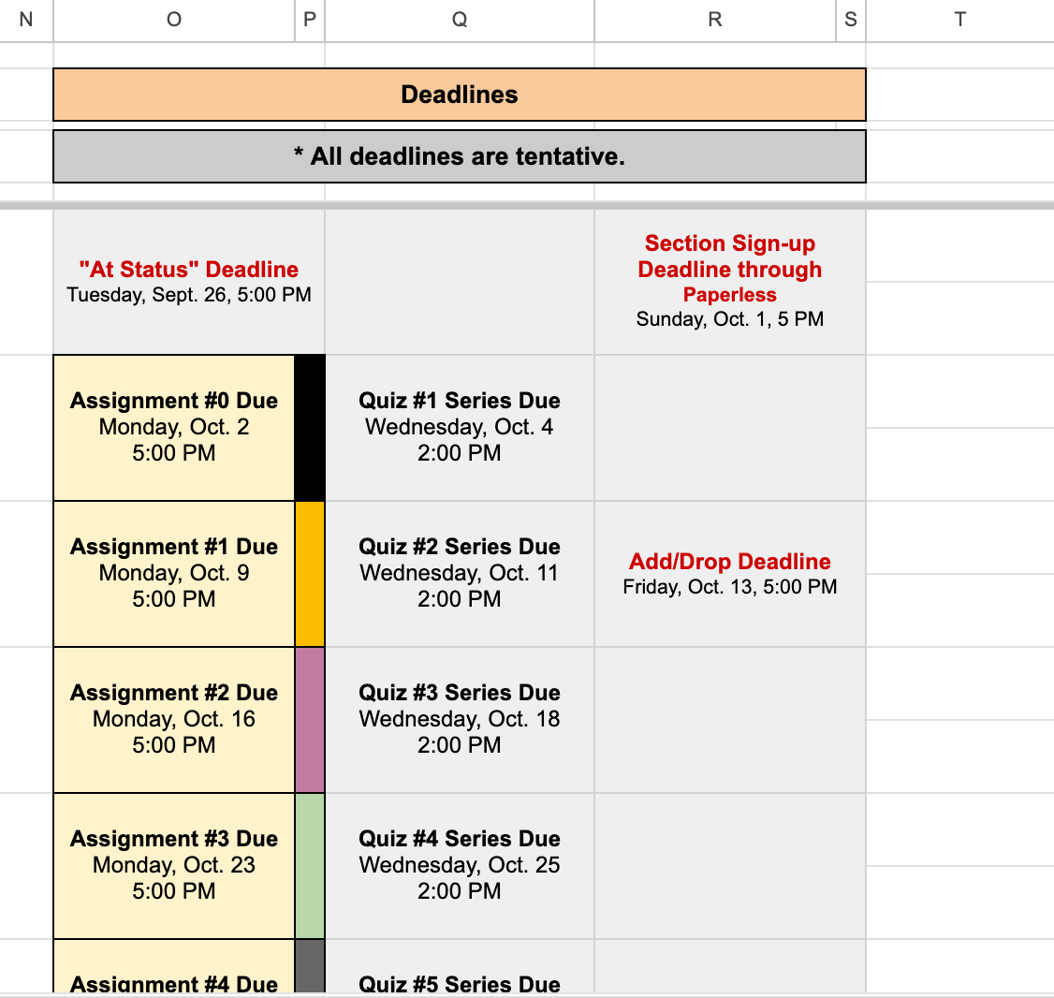
Description
Steven
Florida -> Bay Area
University Lecturer

Slide 15
Description
Every week sits down with husband to coordinate their calendars and plan for the week
Major pain point of scheduling kids activities
Keeping track of activity/summer camp registration
Coordinating play dates with other moms
Finding activities where pick up and drop off work around her and her husband’s work schedule
Xin
Palo Alto, CA
Trust Engineer
Mother of 2 (7 yo, 3.5 yo)
“I still haven’t found a good to do list or planning tool that can help me with both work & the family”

Slide 16
Description
“Starting from 6-years-old or even earlier, my son is so busy that I feel like his secretary.”
Xin
Palo Alto, CA
Trust Engineer
Mother of 2 (7 yo, 3.5 yo)

Slide 17
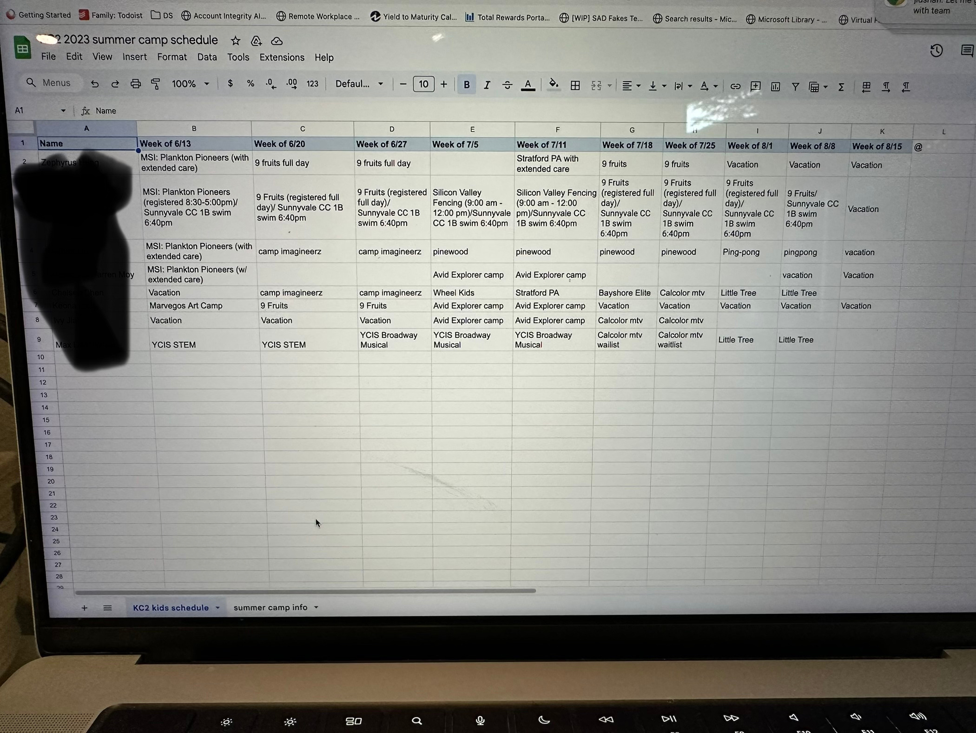
Description
Xin
Palo Alto, CA
Trust Engineer
Mother of 2 (7 yo, 3.5 yo)

Slide 18
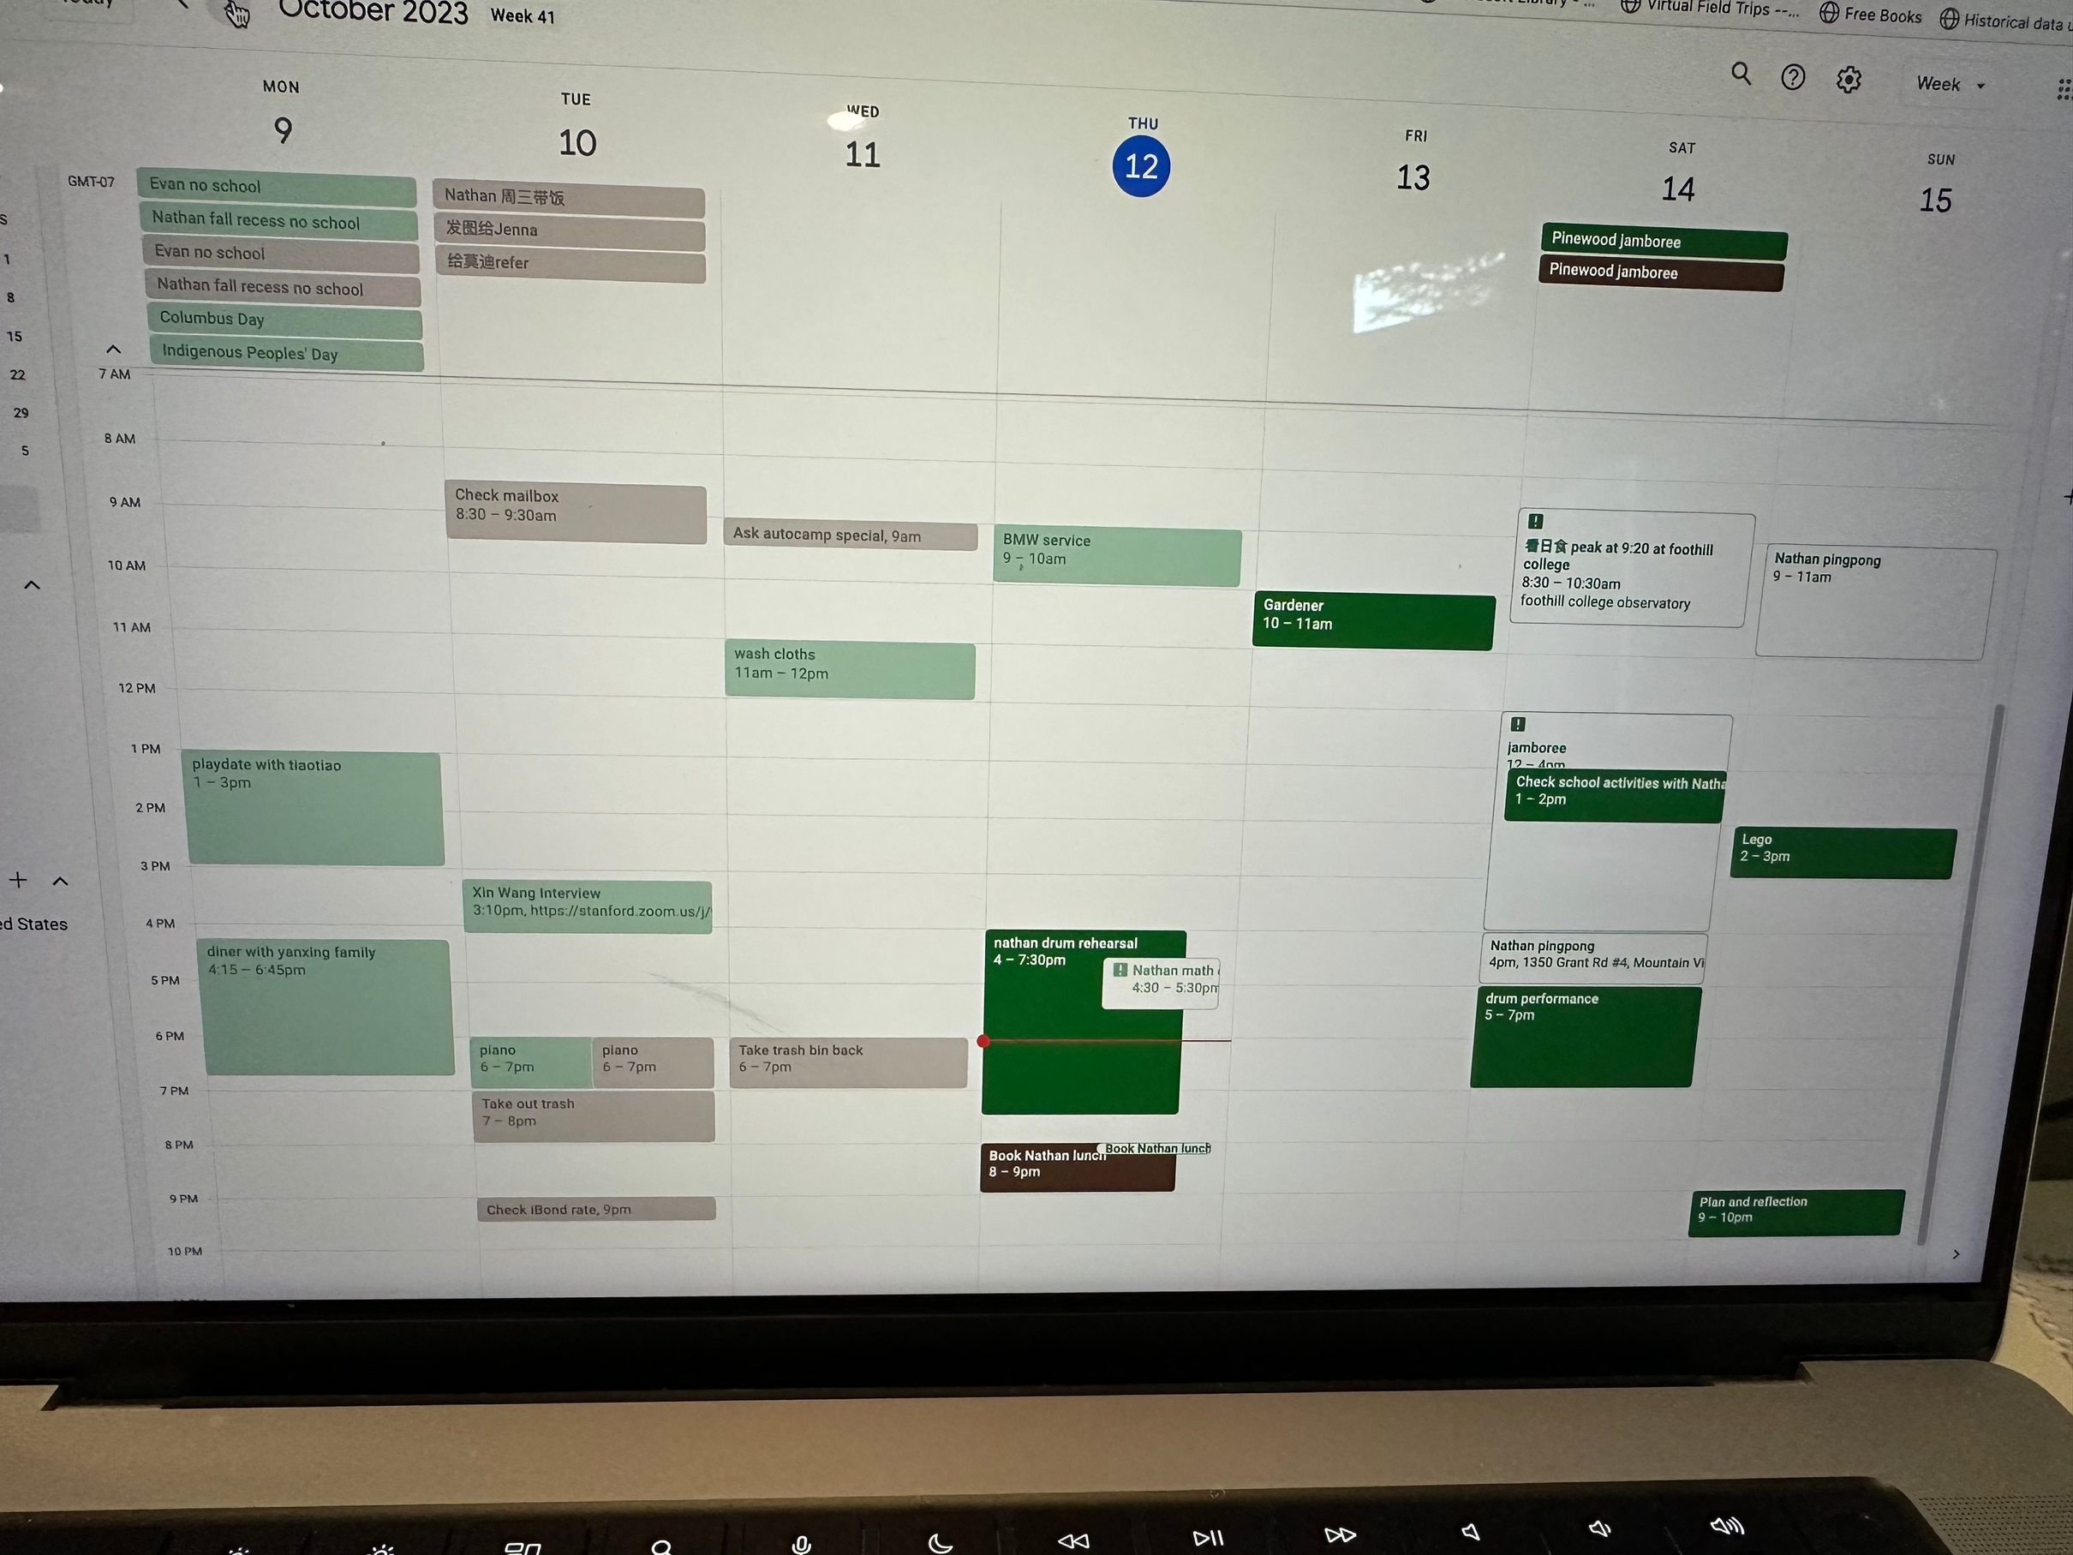
Description
Xin
Palo Alto, CA
Trust Engineer
Mother of 2 (7 yo, 3.5 yo)

Slide 19
Description
Has to email her husband in order to schedule meetings and find time to speak with him
Has to schedule things like yoga classes at least 3-4 days in advance in order to coordinate childcare and pickup logistics with her husband
Every minute of every day is accounted for
Has found that progress her research and writing has substantially slowed down
Irena
Oakland, CA
PWR Instructor
Mother of 1 (3.5 yo)
“My role as a mother is constantly in tension with my role as a scholar.”

Slide 20
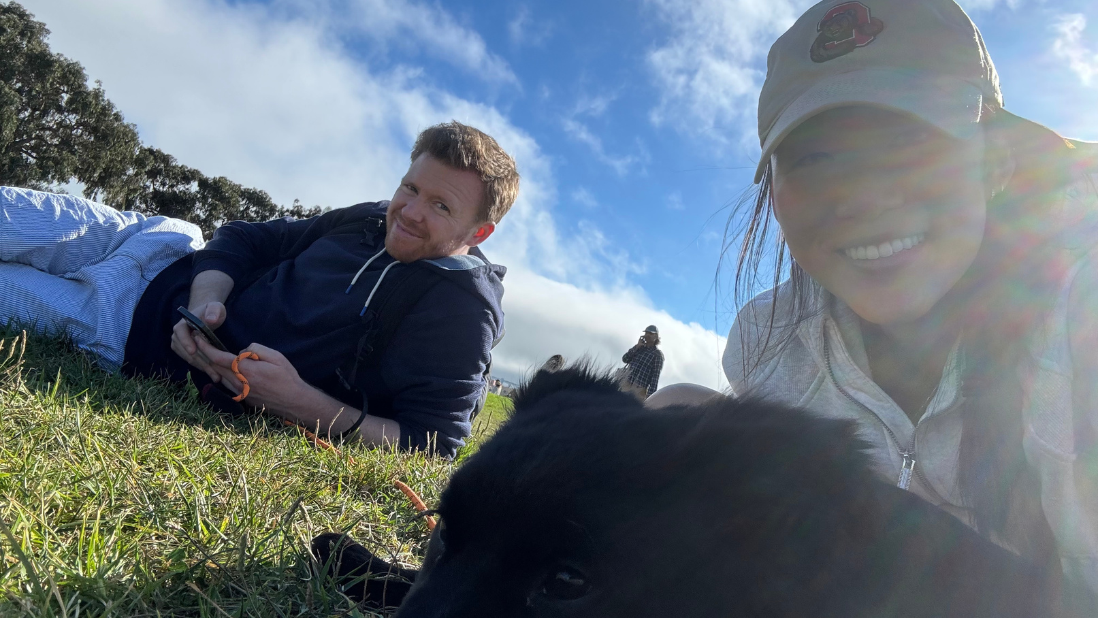
Long distance couple, hard to build in time to talk to each other and visit each other
Find it impossible to find tools that integrate their work and personal calendars welll
Splitting finances and household tasks back when they were living in the same apartment was challenging, asked for tips from friends
Angela & Ben
NYC <-> SF
25 yo & 33 yo
Associates
“You don’t realize how hard integrating your life with another person’s is.”

Slide 21
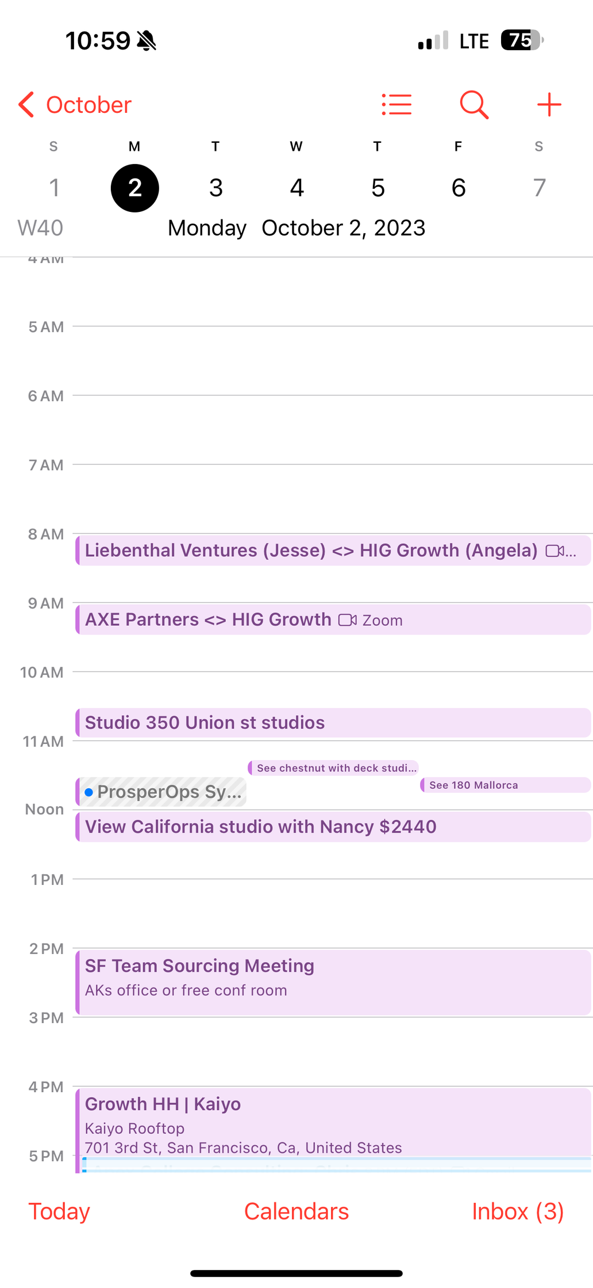
Angela & Ben
NYC <-> SF
25 yo & 33 yo
Associates

Slide 22
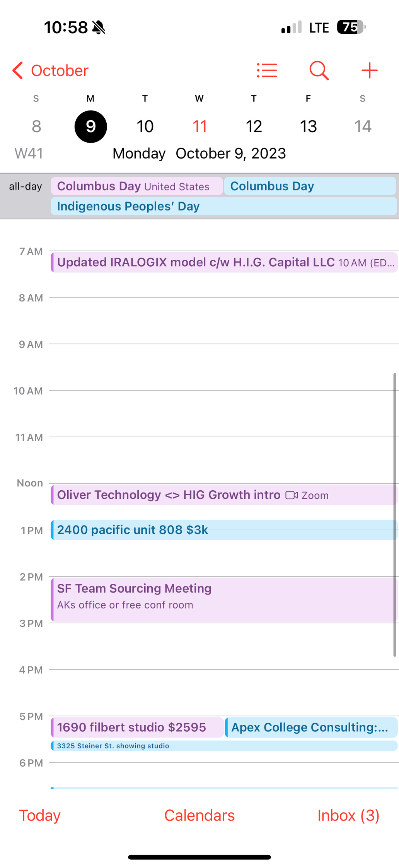
Angela & Ben
NYC <-> SF
25 yo & 33 yo
Associates

Slide 23
03
POVs, HMWs, & Solutions

Slide 24

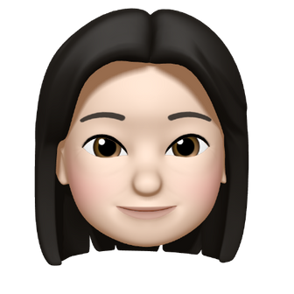
Wei found that people she hired to help around the house never understood what she wanted
The transfer of household information is difficult
Marie found it hard to convey how she wanted tasks done to the RAs
Alex would frequently call his parents and ask about questions about healthcare & car maintenance
Steven thought he got the info he needed from his mom before her passing, but he still has questions

Slide 25
We met . . .
Steven who is transitioning into a lecturing position at a new university, all while coping with the recent loss of his mother and a big move across the country.
We were surprised to realize that . . .
that Steven’s mother had diligently documented important family and personal information before her expected passing, leaving Steven concerned about the potential logistical challenges that could arise upon an unexpected passing of his father.
Steven
We wonder if this means . . .
many families struggle to proactively plan for death, leading to the loss of important family knowledge regarding health, financial, and daily life.
It would be game changing to . . .
simplify the storage and sharing of important family or personal information so that families always have it on hand.

Slide 26
HOW MIGHT WE
ensure that household logistical information is passed down through life transitions?

Slide 27
Solution
Critical Assumptionitical
An app that allows family members to document both quotidian and important information via photo or video. The app will then label the media as some relevant process, and other family members can easily query the app for answers.
People’s first instinct is to reach out to family members for answers to questions regarding health, financial, and daily life.

Slide 28
The Prototype
What hospital were you born in?
We asked users a series of questions, and asked them to tell us how they would go about answering them: “ask my mom,” “google search,” “ask a friend,” “call my provider,” etc.
How do you take care of a wool sweater?
What tires does your car use?
Critical Assumption: People’s first instinct is to reach out to family members for answers to questions regarding health, financial, and daily life,
What does your health insurance cover?

Slide 29
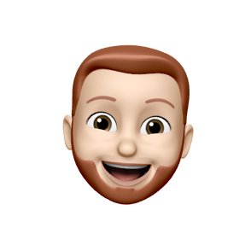

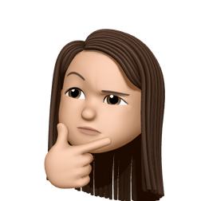
Simon
29 yo Dutch PhD graduate
Testing Participants
James
22 yo senior from NYU
Looking for diversity in age and occupation
Selena
57 yo store manager from San Jose

Slide 30

Results
Simon, 29 yo Dutch PhD graduate
Rarely answered that he would ask his parents anything
What worked
New Learnings
We found patterns among different age groups; younger people tended to ask their mom for more answers
James, 22 yo senior from NYU
Defaulted to asking his parents even for questions that could be looked up like “How to wash a wool sweater”

Slide 31
Results
Selena, 57 yo store manager from San Jose
Already knew the answers to most of the questions
What didn’t work
What worked
New Learnings
Google search was more common than we expected
Some answers were already known or irrelevant to the user
Simon, 29 yo Dutch PhD graduate
Would search or ask experts to answer any questions

Slide 32
Results
New Learnings
Future Testing
No one said “ask my dad”
As people grow older, they rely less on their parents and rely more on Google search, personal knowledge, or directly contacting experts
What is the threshold for information that people are willing to document digitally?
Asking more targeted questions for older people

Slide 33
Complexity of scheduling & task management increases exponentially with more people
Irena had to clear any plans she made with her husband 3-4 days in advance to coordinate childcare
Angela & Ben splitting rent and finances difficult
Xin had difficulties coordinating with other families & her husband when it came to her child’s activities
Steven custom built complex spreadsheets in order to schedule meetings with his TAs

Slide 34
We met . . .
Xin, a mother juggling the responsibilities of raising two young children while maintaining a full-time position as a Trust Engineer at LinkedIn.
We were surprised to realize that . . .
she feels like her 7-year-old son’s “secretary” because she spends so much time scheduling her son’s various activities.
Xin
We wonder if this means . . .
Xin feels like the logistical requirements of managing her son takes away from actually enjoying her relationship and time with him.
It would be game changing to . . .
ease Xin’s mental burden when coordinating each family member’s schedule.

Slide 35
HOW MIGHT WE
relieve the mental burden of scheduling in personal, relationship, and familial settings?

Slide 36
Solution #2
Critical Assumptionitical
An app/extension that judges whether or not you can schedule certain plans based on your location, traffic, personal “dawdle” history, destination, and more. Will also optimize routes based on tasks you need to complete but haven’t scheduled like getting gas, picking up a prescription, buying groceries, etc.
People are overly ambitious when scheduling plans and making to-do lists for the day; they tend to miss events or forget about tasks or show up late.

Slide 37
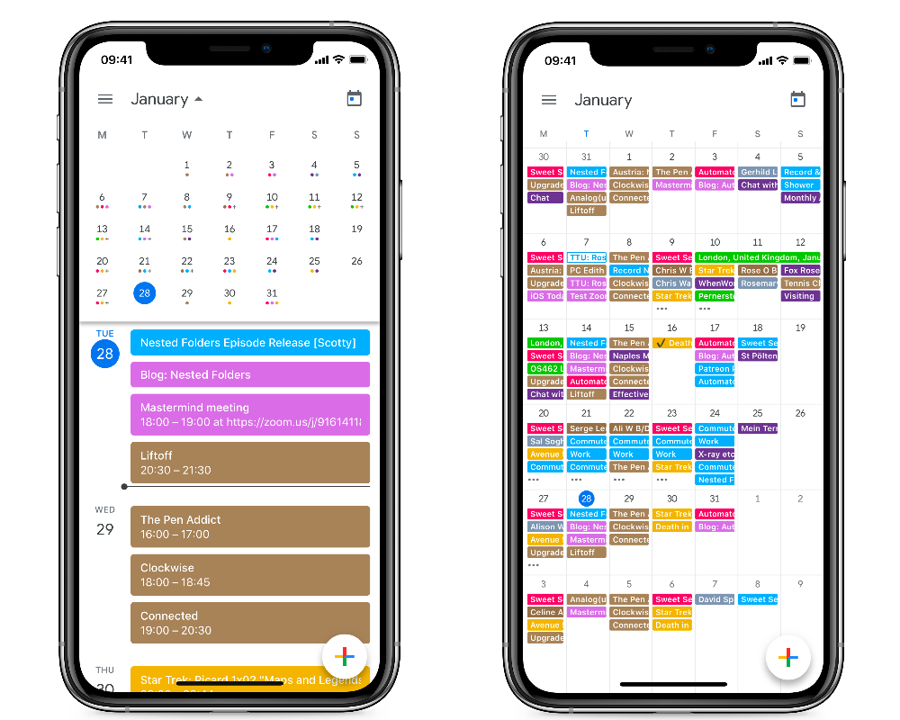
The Prototype
We asked people to walk us through a past day on their calendar, and whether of not they actually completed all the tasks they wanted to complete. If not, why not?
Critical Assumption: People are overly ambitious when scheduling plans and making to-do lists for the day; they tend to miss events or forget about tasks or show up late.

Slide 38
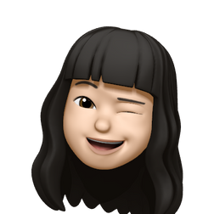


Amy
42 yo Cambodian small business owner
Testing Participants
Daphne
50 yo accountant & mother of 3
Looking for diversity in age, occupation, and levels of busyness
Kyle
22 yo junior from Georgetown

Slide 39
Results
Amy, 42 yo Cambodian small business owner
Physical calendar & alarms
What worked
Everyone has some system in place for managing their day: mental notes, physical notebook, reminders app, physical calendar, etc.
Daphne, 50 yo accountant & mother of 3
Work calendar & mental notes
Kyle, 22 yo junior from Georgetown
Reminders app and Google Calendar

Slide 40
Results
Amy, 42 yo Cambodian small business owner
Didn’t need to write down most of her tasks
What worked
What didn’t work
People did not really want to share too much of their personal calendars with us
Many users do not put personal plans in the calendar (picking up kids, lunch with friends, etc.)
Daphne, 50 yo accountant & mother of 3
Had kids text her when they needed pickup
Remembered all daily activities

Slide 41
Results
New Learnings
Missed Critical Assumption:
People’s days are filled with personal tasks and events that are not explicitly written into their calendars
Calendars are not always accurate
Most important tasks always got done (ie. work meetings, picking up kids)
People need to record their schedule.
We realized...
Many people have an everyday routine that doesn’t really change, and thus doesn’t need to be written down.
As students, we missed that because our schedules change all the time.

Slide 42
People tend to really like things recommended by people they trust
Alex liked tools recommended by people he followed on tech twitter
Wei liked getting school recs from Nextdoor & friends
Steven got good dentist and restaurant recs from friends
Angela & Ben liked personal finance tips from their friends

Slide 43
We met . . .
Wei, a stay-at-home mother who is the primary caretaker of her 7-year-old son.
We were surprised to realize that . . .
Helpers recommended to Wei by friends and neighbors were consistently better than those found through other means, like websites or agencies.
Wei
We wonder if this means . . .
that people generally trust and prefer the opinions of those in their network, even if they are inconsistent with the opinions of a larger amount of strangers.
It would be game changing to . . .
easily connect Wei to advice, information, and recommendations from friends or those who have similar values and perspectives as her.

Slide 44
HOW MIGHT WE
increase the number of relevant, high quality recommendations people receive for services which have a high personal preference factor?

Slide 45
Solution #3
Critical Assumptionitical
An app where you can browse reviews for services such as childcare, haircuts, and therapy among people in your network. See what services your friends like and/or dislike, and even assess the opinions of friends of friends.
People generally trust and prefer the opinions of those in their network, even if they are inconsistent with the opinions of a larger number of strangers.

Slide 46
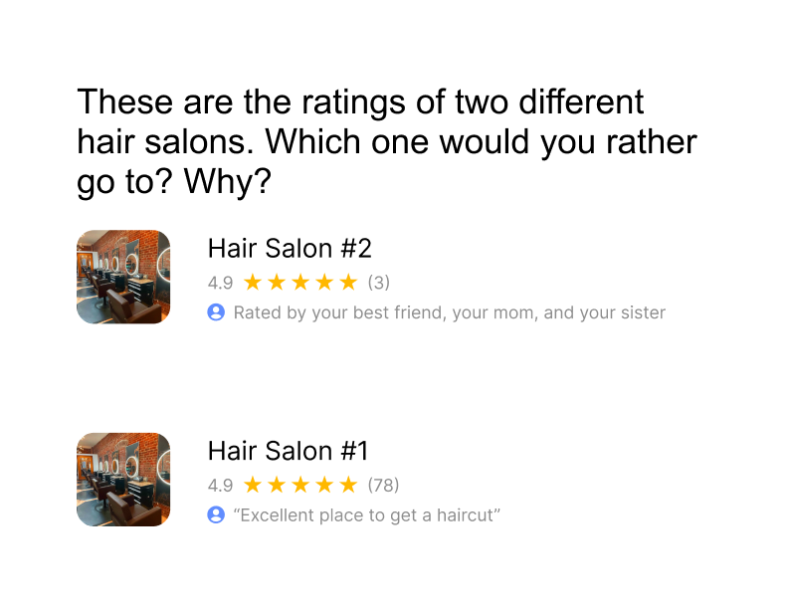
The Prototype
We had users pick between two services based on reviews left by friends and the public. Users picked between services liked by friends and disliked by the public or vice versa.
Critical Assumption: People generally trust and prefer the opinions of those in their network, even if they are inconsistent with the opinions of a larger number of strangers.

Slide 47
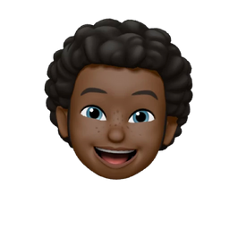

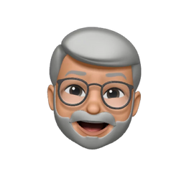
Tobias
20 yo designer from LA
Testing Participants
Monika
48 yo professor from England
Looking for diversity in age, occupation, and geographic origin
Frank
65 yo neurologist from Canada

Slide 48
Endorsed by family and friends.
Both salons have the same average rating of 4.9 stars.
Has more reviews

Slide 49
“I can’t just go to any barber. They need to understand my hair .”
“I’m not really picky with my hair. It’s more about convenience for me.”

Slide 50
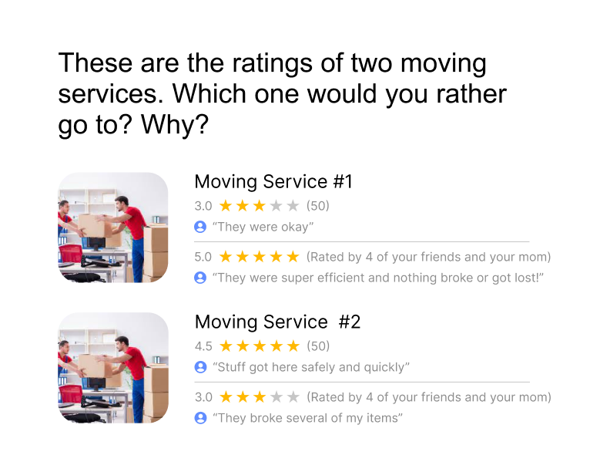
Average - low public rating, high familial rating.
Both services have same amount of public and known reviewers.
High public rating, average - low rating from family & friends.

Slide 51
“Movers are either good or bad. I’m looking for consistency.”

Slide 52
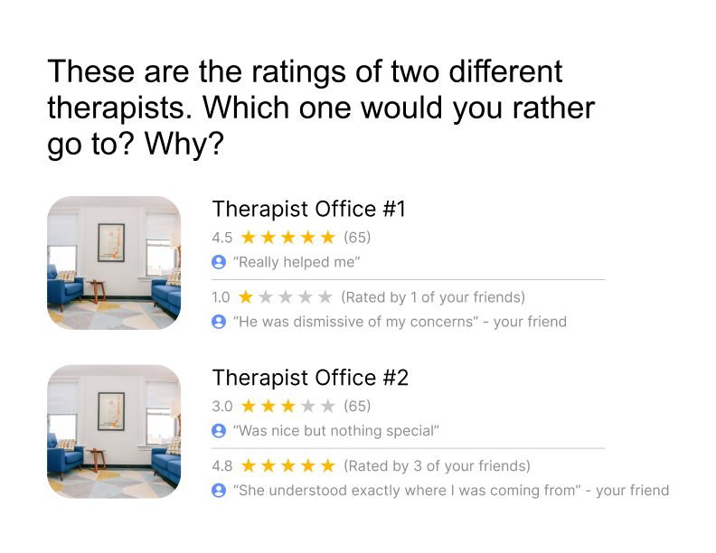
Highly reviewed by public, but bad review from friend.
Average-low public review, but highly reviewed by friends.

Slide 54
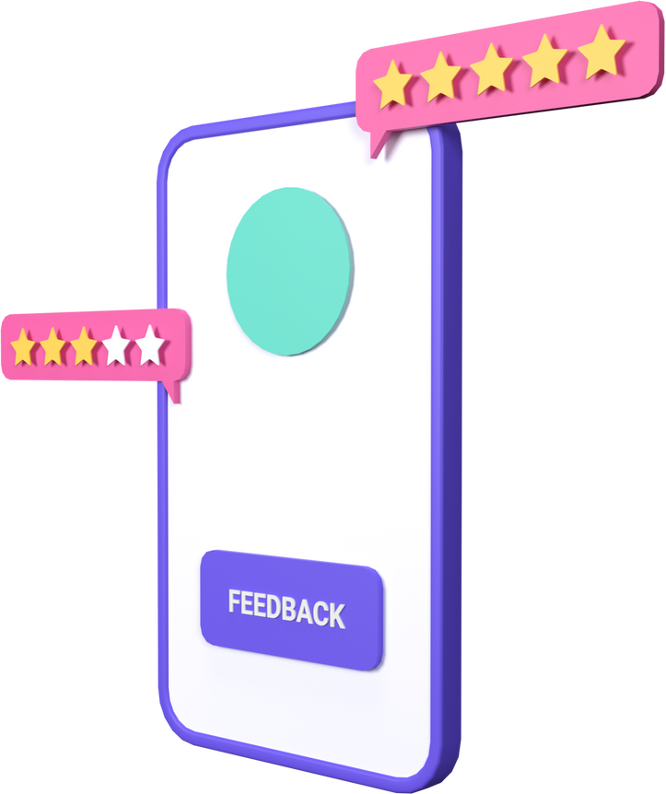
Results
What worked
What didn’t work
Prototype was straightforward
People nearly always picked the service with better friend reviews, even if public reviews were equally good and more numerous
When it came to less personal services like moving services, some people were more inclinced to trust the public reviews

Slide 55

Results
New Learnings
People place more value on friends’ opinions when the service they are seeking is more personal (therapy as opposed to moving company)
People who have been reviewed poorly (Amy and Steven) were distrustful of bad reviews online because they know that sometimes customers have unlucky experiences
“I want to give everybody a chance”

Slide 56
04
Moving Forward

Slide 57
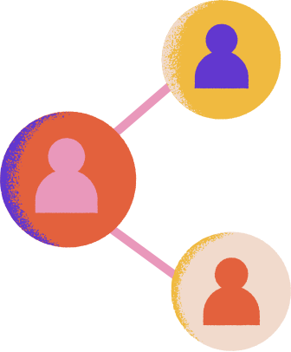
What’s Next?
We found that the third experience prototype yielded the most consistent, actionable insight: people heavily value the opinions and preferences of friends and family when it comes to picking personal services.
This pattern seemed to hold true even when the “public reviews” are great and numerous.

Slide 58

Final Solution
SOLUTION #3:
An app where you can browse reviews for services such as childcare, haircuts, and therapy among people in your network. See what services your friends like and/or dislike, and even assess the opinions of friends of friends.

Slide 59
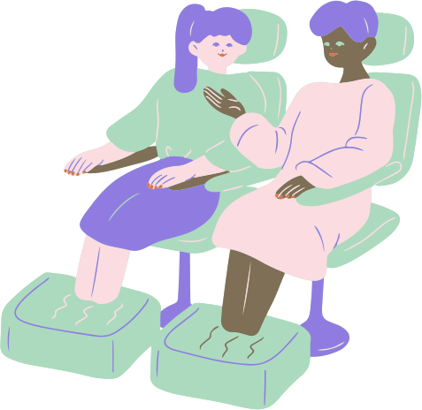
Ethical Implications
1.
A friend or family based review system can create echo chambers of opinions, as your network is probably similar to you

Slide 60
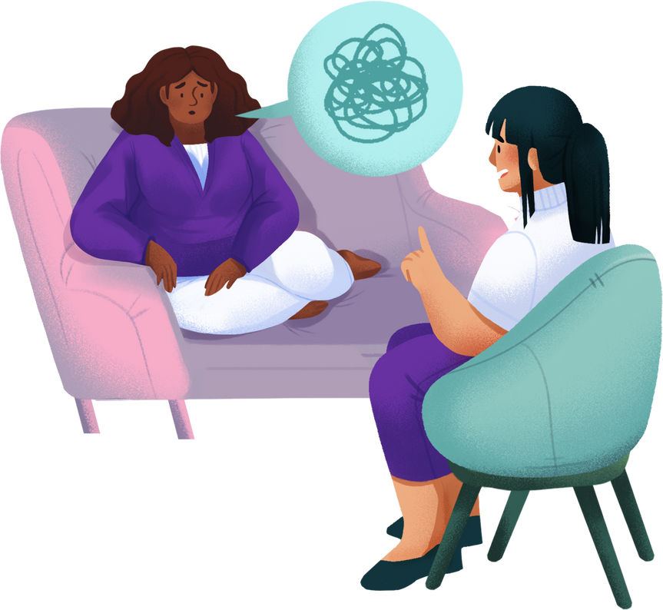
Ethical Implications
2.
People may feel pressured to disclose personal information like therapists and/or doctors, even to their friend networks

Slide 61
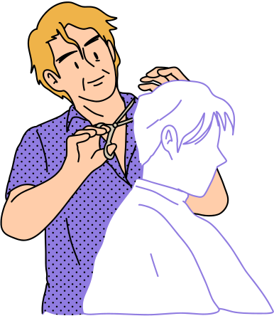
Ethical Implications
3.
Fewer reviews, even if they are given by trusted connections, may be unfair to merchants if a single customer had a bad experience by chance and left a terrible review

Slide 62

People who care a lot about the quality of their services
Who does it serve?
People who want to hear reviews from a demographic that’s different from the general population (reviews from people of the same ethnicity, gender, etc.)

Slide 63

People who need more specialized services (people with disabilities, learning disorders, etc.)
People whose networks live very different lifestyles from them
Who does it leave out?
Non-tech savvy
people
People who live far away from their networks

Slide 64
Extra Content
Appendix

Slide 65

We met . . .
Ann, a mother of 3 children, who co-parents with her ex-husband while raising her youngest with her current husband while being the CEO of a successful company.
We were surprised to realize that . . .
While Ann claims to be really social and knows a lot of the parents and people within her local community, she feels lonely and lacks someone to share her intellectual interests with
Ann
We wonder if this means . . .
She feels trapped by the context in which her friends know her (as a mother, as a CEO, etc.)
It would be game changing to . . .
Find an organic way for Ann to meet people with similar interests that accommodates her busy schedule.
Initial POV

Slide 66
Wei HMW
Brainstorm
Put Wei in contact with neighbors, who may have similar social, political, and economic situations?
Make public reviews equally trustworthy and valuable?
Connect Wei with helpers who match the experience she is looking for?
Put Wei in contact with friends of friends, who may have similar values?
Ensure that the helpers Wei hires are well-trained and receptive to feedback, regardless of how she hired them?
Allow Wei to see what all her friends think about a product or service?
Automate some of the processes or chores she needs help with?
Help word-of-mouth advice spread faster?
Better communicate Wei’s specific parenting and organizational preferences to her helpers?
Make it unnecessary to hire help

Slide 67
Xin HMW
Brainstorm
Alleviate concerns about arriving and departing places on time?
Redesign the UI of the digital calendar to better visualize the various commitments of each family member
Establish a system of scheduling boundaries that allows for a more regular routine
Relieve the mental burden of scheduling in personal, relationship, and familial settings
Offer Xin personalized scheduling suggestions based on her work schedule, her family’s commitments, & her personal tasks?
Automatically analyze Xin’s family’s schedule and offer paths to optimization?
Leverage other parents with scheduling logistics like carpooling?
Foster a network for busy parents to share strategies for managing family schedules
Create more opportunities for shared family activities rather than individual activities that require more logistical coordination
Encourage Xin’s son to assist in managing his own schedule

Slide 68
Steven HMW
Brainstorm
allow Sean to inherit his parents’ assets and account management without explicit passwords or permission (in the absence of a will)?
consolidate all the accounts tied to your name in one place?
automatically update out of date information regarding stevens address, family members, financial situatio etc
we make moving a process that doesn’t involve finding new dentists, doctors, etc.
consolidate all this personal, health, and financial information into one secure cloud account?
make the process of asking parents about generational knowledge less awkward?
ensure that household logistical information is passed down through life transitions?
make family planning for death a non-taboo subject?
make the documentation of family information a passive activity?
inspire people to be better prepared to pass on their assets/info in the event of their death?

Slide 69
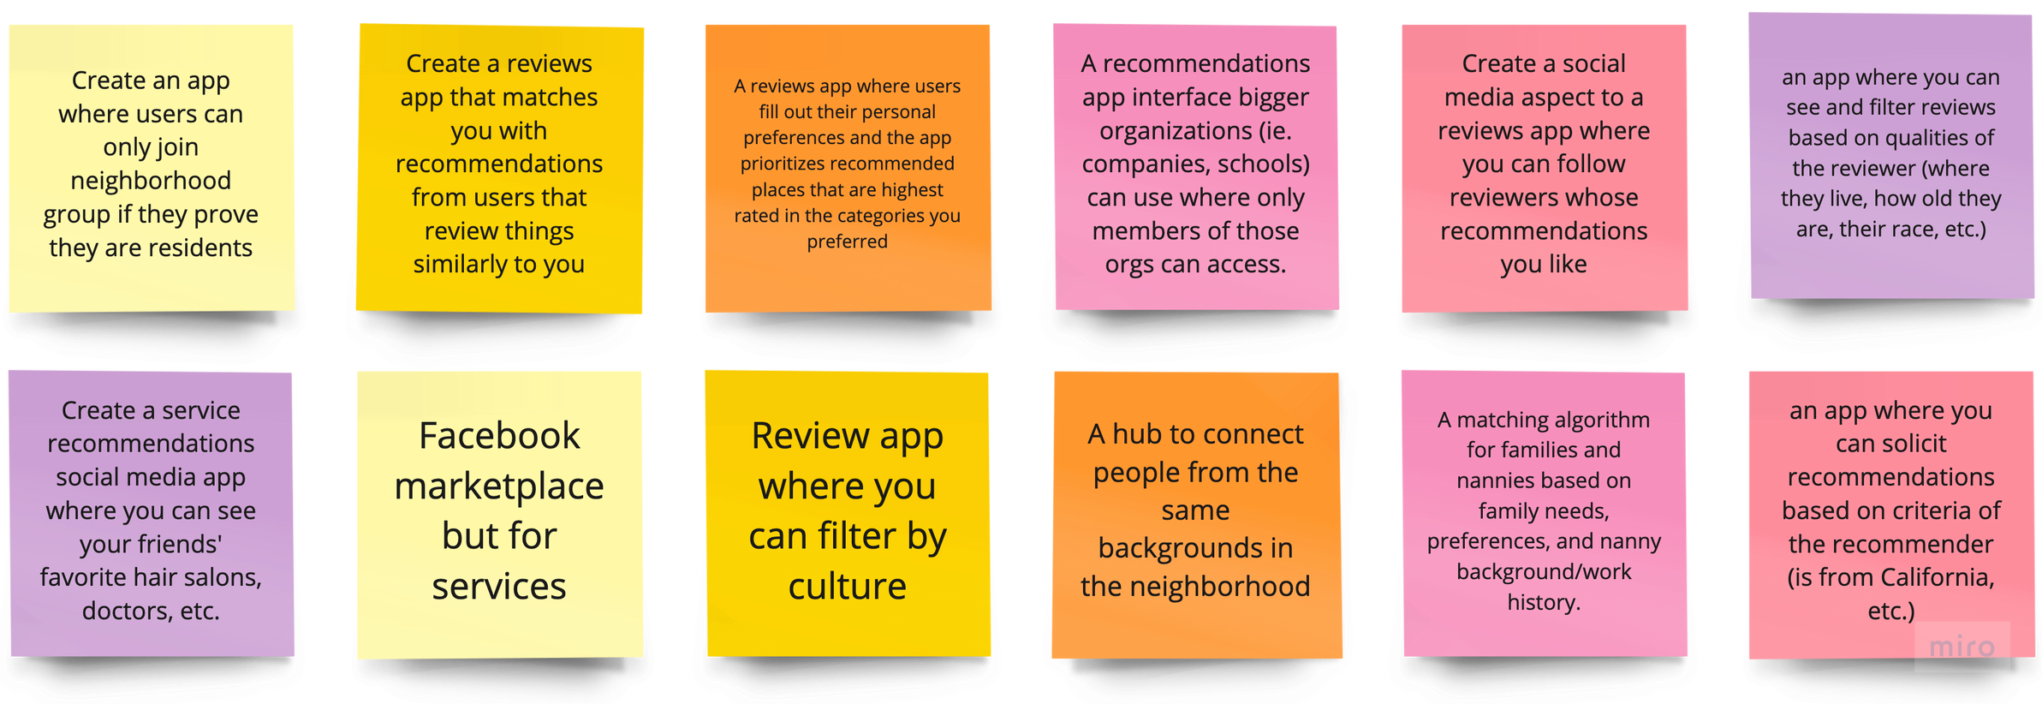
Solution Brainstorm
Made on Miro
HMW increase the number of relevant, high quality recommendations people receive for services which have a high personal preference factor?

Slide 70
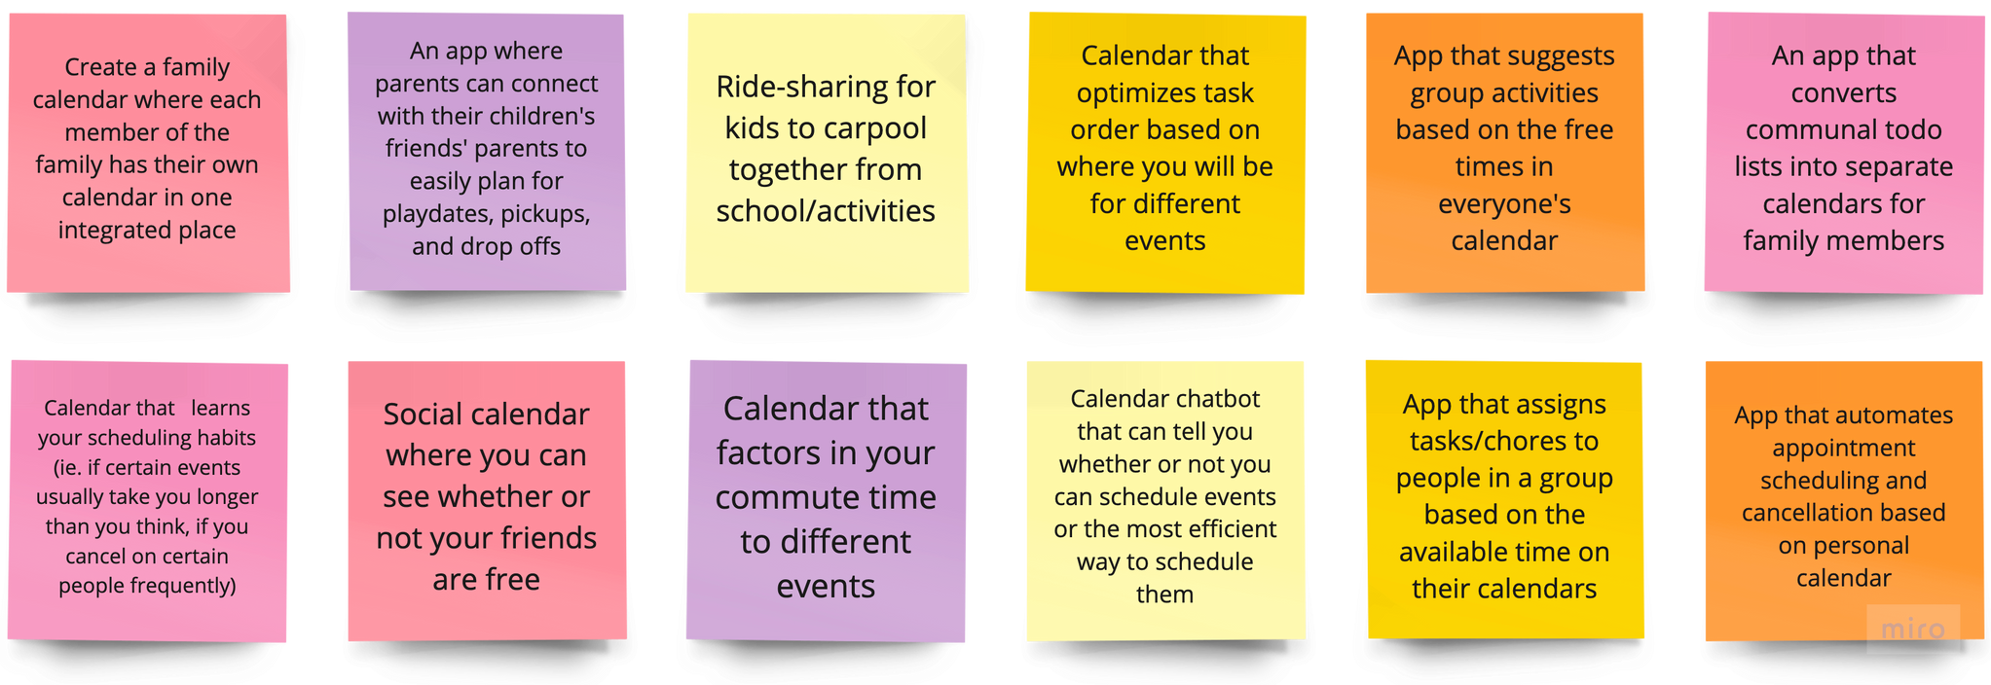
Solution Brainstorm
Made on Miro
HMW relieve the mental burden of scheduling in personal, relationship, and familial settings?

Slide 71
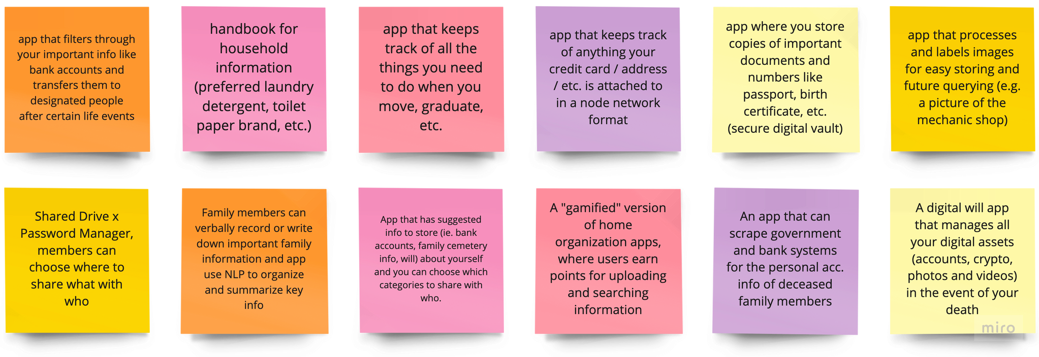
Solution Brainstorm
Made on Miro
HMW ensure that household logistical information is passed down through life transitions?

